Slide 1
Basic Concepts
Assembly Programming Language
Computer Science Department
ACT

Slide 2
Overview
Assembly-, Machine-, and High-Level Languages
Assembly Language Programming Tools
Programmer’s View of a Computer System
Data Representation

Slide 3
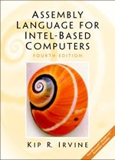
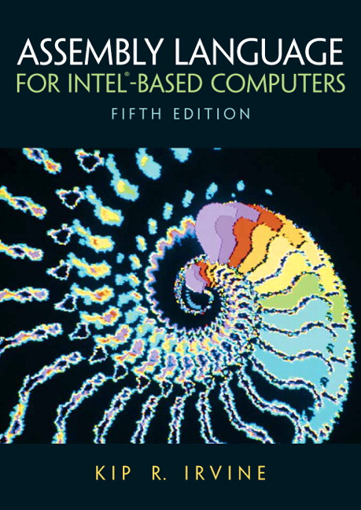
Textbook
Kip Irvine: Assembly Language for Intel-Based Computers
  4th edition is now available in the bookstore
  5th edition is coming soon but not available this semester
Read the textbook!
  Key for learning and obtaining a good grade

Slide 4
Goals and Required Background
Goals: broaden student’s interest and knowledge in …
  Basic organization of a computer system
  Intel IA-32 processor architecture
  How to write assembly language programs
  How high-level languages translate into assembly language
  Interaction between the assembly language programs, libraries, the operating system, and the hardware
  How interrupts, system calls, and handlers work
  How to debug a program at the machine level
Required Background
  The student should already be able to program confidently in at least one high-level programming language, such as Java or C.

Slide 5
Grading Policy
Laboratory 25%
Midterm Exam 25%
Final Exam 50%

Slide 6
Next …
Assembly-, Machine-, and High-Level Languages
Assembly Language Programming Tools
Programmer’s View of a Computer System
Data Representation

Slide 7
Some Important Questions to Ask
What is Assembly Language?
Why Learn Assembly Language?
What is Machine Language?
How is Assembly related to Machine Language?
What is an Assembler?
How is Assembly related to High-Level Language?
Is Assembly Language portable?

Slide 8
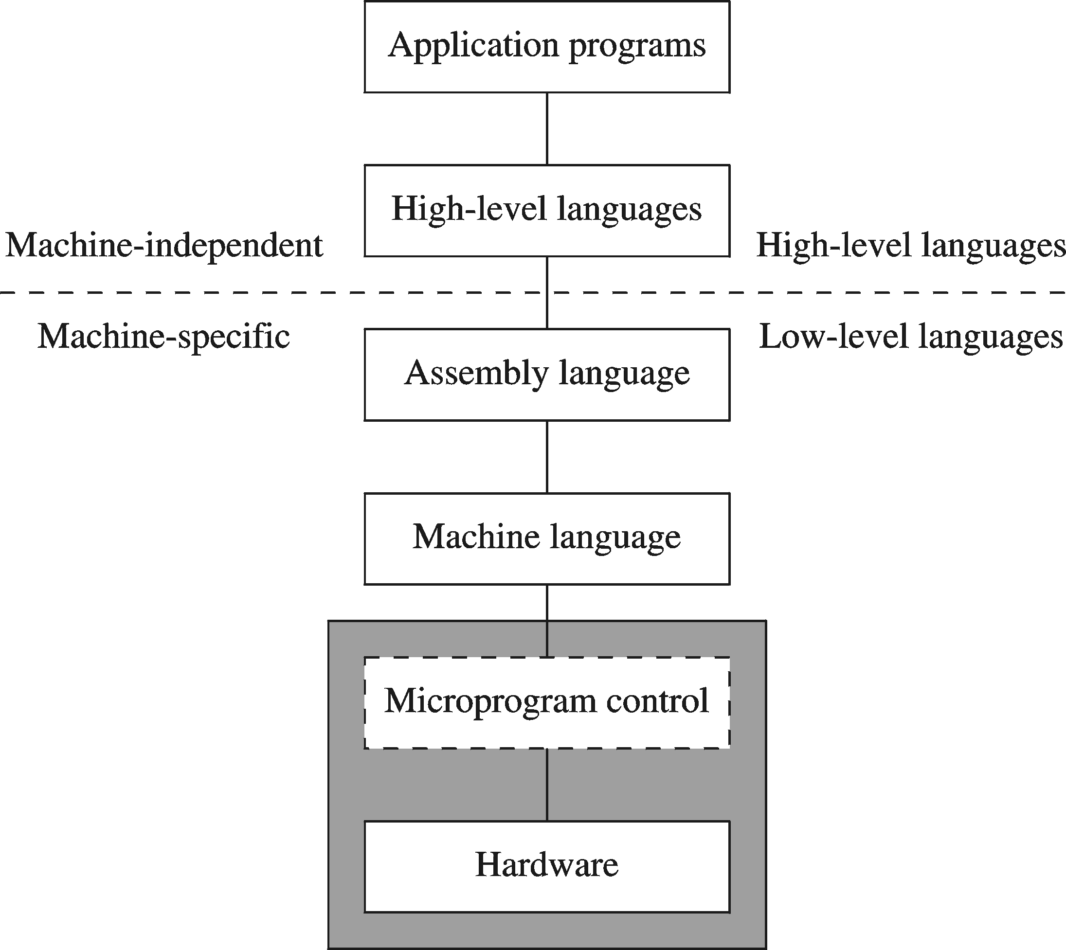
A Hierarchy of Languages

Slide 9
Assembly and Machine Language
Machine language
  Native to a processor: executed directly by hardware
  Instructions consist of binary code: 1s and 0s
Assembly language
  Slightly higher-level language
  Readability of instructions is better than machine language
  One-to-one correspondence with machine language instructions
Assemblers translate assembly to machine code
Compilers translate high-level programs to machine code
  Either directly, or
  Indirectly via an assembler

Slide 10
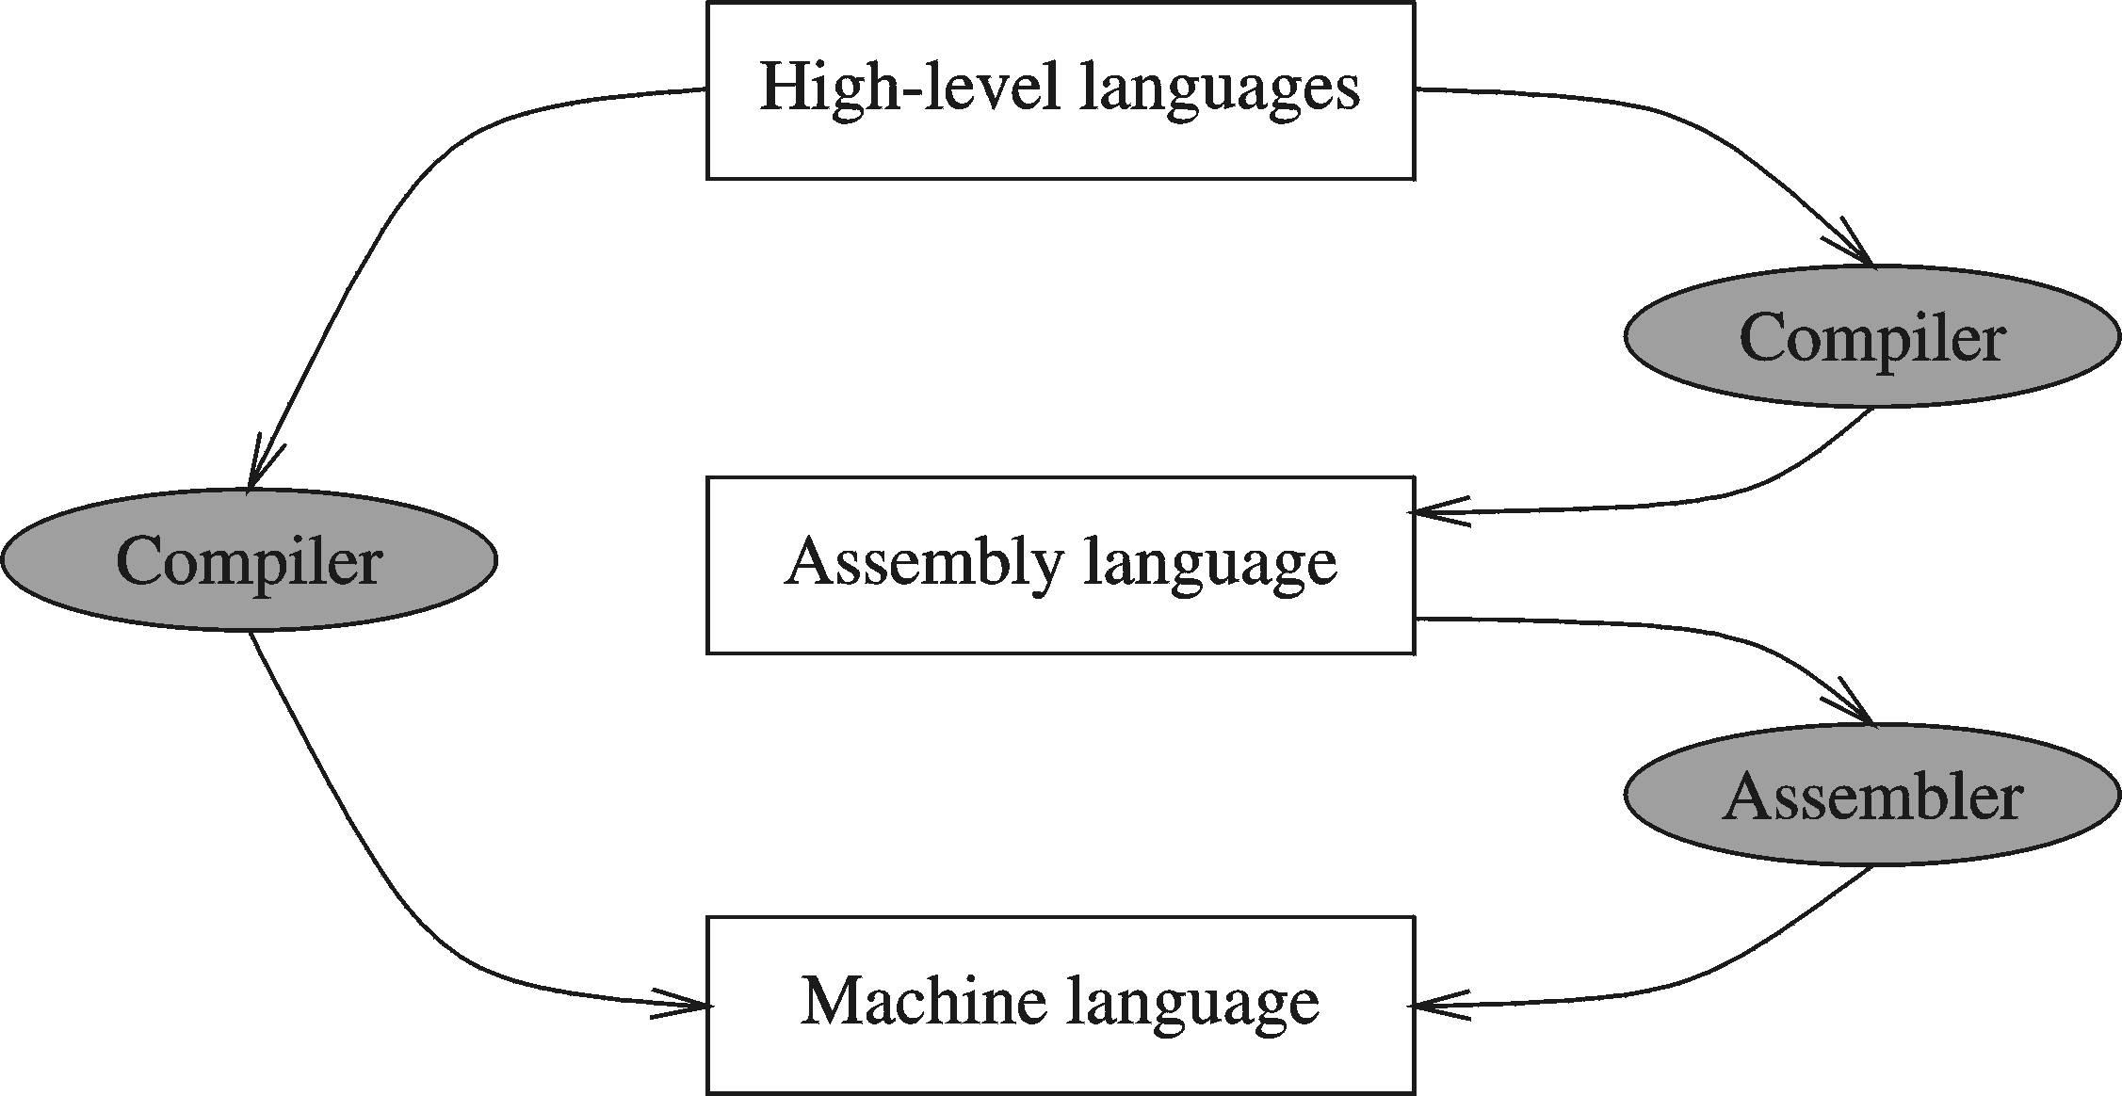
Compiler and Assembler

Slide 11
Translating Languages
English: D is assigned the sum of A times B plus 10.
High-Level Language: D = A * B + 10
A statement in a high-level language is translated typically into several machine-level instructions
Intel Assembly Language:
mov eax, A
mul B
add eax, 10
mov D, eax
Intel Machine Language:
A1 00404000
F7 25 00404004
83 C0 0A
A3 00404008

Slide 12
Advantages of High-Level Languages
Program development is faster
  High-level statements: fewer instructions to code
Program maintenance is easier
  For the same above reasons
Programs are portable
  Contain few machine-dependent details
    Can be used with little or no modifications on different machines
  Compiler translates to the target machine language
  However, Assembly language programs are not portable

Slide 13
Why Learn Assembly Language?
Two main reasons:
  Accessibility to system hardware
  Space and time efficiency
Accessibility to system hardware
  Assembly Language is useful for implementing system software
  Also useful for small embedded system applications
Space and Time efficiency
  Understanding sources of program inefficiency
  Tuning program performance
  Writing compact code

Slide 14
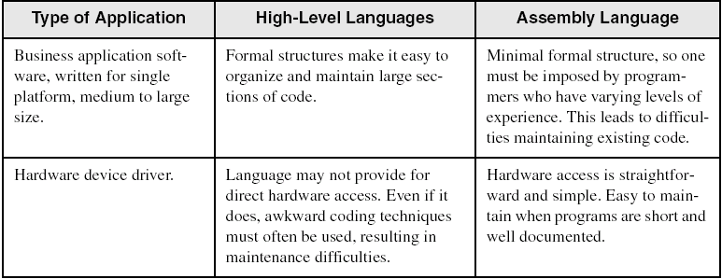
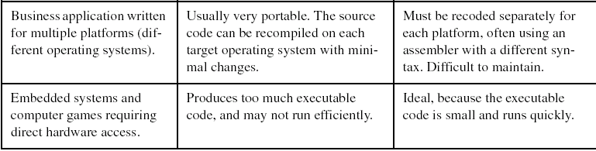
Assembly vs High-Level Languages
Some representative types of applications:

Slide 15
Next …
Welcome to COE 205
Assembly-, Machine-, and High-Level Languages
Assembly Language Programming Tools
Programmer’s View of a Computer System
Data Representation

Slide 16
Assembler
Software tools are needed for editing, assembling, linking, and debugging assembly language programs
An assembler is a program that converts source-code programs written in assembly language into object files in machine language
Popular assemblers have emerged over the years for the Intel family of processors. These include …
  TASM (Turbo Assembler from Borland)
  NASM (Netwide Assembler for both Windows and Linux), and
  GNU assembler distributed by the free software foundation
You will use MASM (Macro Assembler from Microsoft)

Slide 17
Linker and Link Libraries
You need a linker program to produce executable files
It combines your program's object file created by the assembler with other object files and link libraries, and produces a single executable program
LINK32.EXE is the linker program provided with the MASM distribution for linking 32-bit programs
We will also use a link library for input and output
Called Irvine32.lib developed by Kip Irvine
  Works in Win32 console mode under MS-Windows

Slide 18
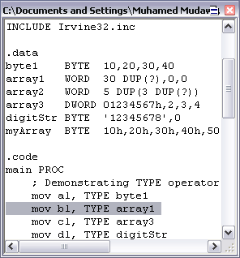
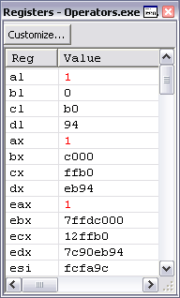
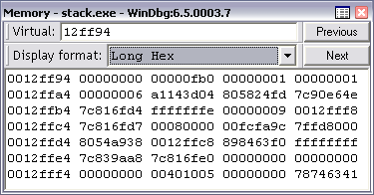
Debugger
Allows you to trace the execution of a program
Allows you to view code, memory, registers, etc.
You will use the 32-bit Windows debugger

Slide 19
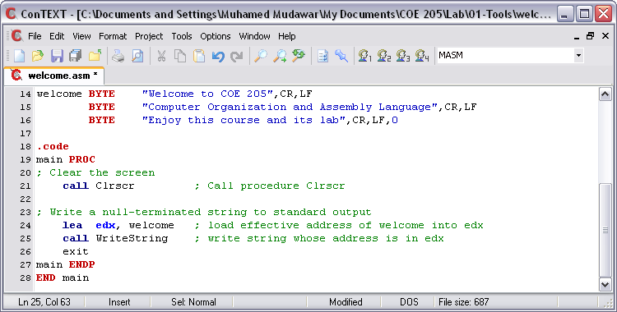
Editor
Allows you to create assembly language source files
Some editors provide syntax highlighting features and can be customized as a programming environment

Slide 20
Next …
Welcome to COE 205
Assembly-, Machine-, and High-Level Languages
Assembly Language Programming Tools
Programmer’s View of a Computer System
Data Representation

Slide 21
Programmer’s View of a Computer System
Increased level of abstraction
Application Programs
High-Level Language
Level 5
Assembly Language
Level 4
Operating System
Level 3
Instruction Set
Architecture
Level 2
Microarchitecture
Level 1
Each level hides the details of the level below it
Digital Logic
Level 0

Slide 22
Programmer's View – 2
Application Programs (Level 5)
  Written in high-level programming languages
  Such as Java, C++, Pascal, Visual Basic . . .
  Programs compile into assembly language level (Level 4)
Assembly Language (Level 4)
  Instruction mnemonics are used
  Have one-to-one correspondence to machine language
  Calls functions written at the operating system level (Level 3)
  Programs are translated into machine language (Level 2)
Operating System (Level 3)
  Provides services to level 4 and 5 programs
  Translated to run at the machine instruction level (Level 2)

Slide 23
Programmer's View – 3
Instruction Set Architecture (Level 2)
  Specifies how a processor functions
  Machine instructions, registers, and memory are exposed
  Machine language is executed by Level 1 (microarchitecture)
Microarchitecture (Level 1)
  Controls the execution of machine instructions (Level 2)
  Implemented by digital logic (Level 0)
Digital Logic (Level 0)
  Implements the microarchitecture
  Uses digital logic gates
  Logic gates are implemented using transistors

Slide 24
Next …
Welcome to COE 205
Assembly-, Machine-, and High-Level Languages
Assembly Language Programming Tools
Programmer’s View of a Computer System
Data Representation

Slide 25
Data Representation
Binary Numbers
Hexadecimal Numbers
Base Conversions
Integer Storage Sizes
Binary and Hexadecimal Addition
Signed Integers and 2's Complement Notation
Binary and Hexadecimal subtraction
Carry and Overflow
Character Storage

Slide 26
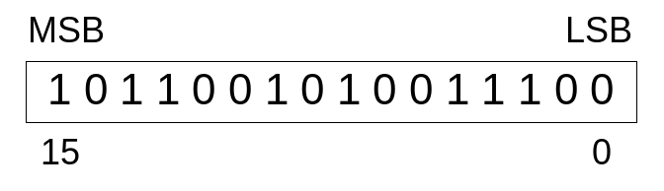
Binary Numbers
Digits are 1 and 0
  1 = true
  0 = false
MSB – most significant bit
LSB – least significant bit
Bit numbering:

Slide 27

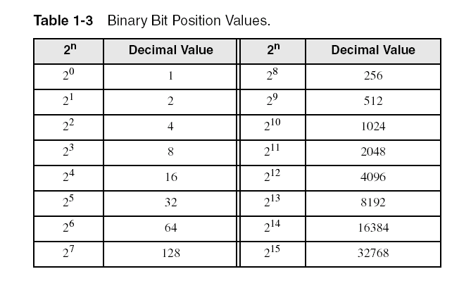
Binary Numbers
Each digit (bit) is either 1 or 0
Each bit represents a power of 2:
Every binary number is a sum of powers of 2

Slide 28
Converting Binary to Decimal
Weighted positional notation shows how to calculate the decimal value of each binary bit:
Decimal = (d_{n-1} × 2^{n-1}) + (d_{n-2} × 2^{n-2}) + ... + (d₁ × 2¹) + (d₀ × 2⁰)
d = binary digit
binary 00001001 = decimal 9:
(1 × 2³) + (1 × 2⁰) = 9

Slide 29
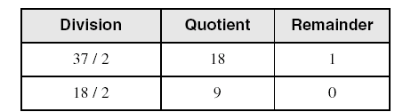
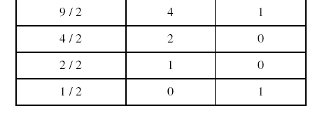
Convert Unsigned Decimal to Binary
Repeatedly divide the decimal integer by 2. Each remainder is a binary digit in the translated value:
least significant bit
most significant bit
37 = 100101
stop when quotient is zero

Slide 30
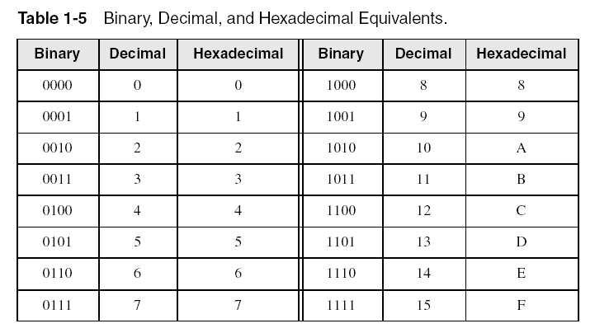
Hexadecimal Integers
Binary values are represented in hexadecimal.

Slide 31

Converting Binary to Hexadecimal
Each hexadecimal digit corresponds to 4 binary bits.
Example: Translate the binary integer 000101101010011110010100 to hexadecimal:

Slide 32
Converting Hexadecimal to Decimal
Multiply each digit by its corresponding power of 16:
Decimal = (d₃ × 16³) + (d₂ × 16²) + (d₁ × 16¹) + (d₀ × 16⁰)
d = hexadecimal digit
Examples:
  Hex 1234 = (1 × 16³) + (2 × 16²) + (3 × 16¹) + (4 × 16⁰) =
  Decimal 4,660
  Hex 3BA4 = (3 × 16³) + (11 * 16²) + (10 × 16¹) + (4 × 16⁰) =
  Decimal 15,268

Slide 33
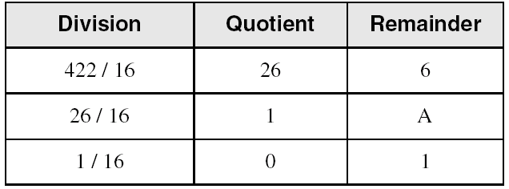
Converting Decimal to Hexadecimal
Repeatedly divide the decimal integer by 16. Each remainder is a hex digit in the translated value:
least significant digit
most significant digit
stop when quotient is zero
Decimal 422 = 1A6 hexadecimal

Slide 34

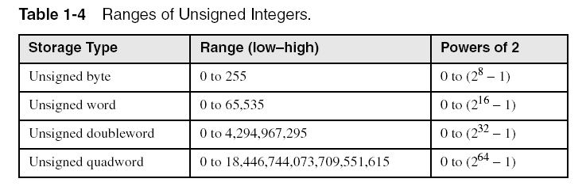
Integer Storage Sizes
Standard sizes:
What is the largest unsigned integer that may be stored in 20 bits?

Slide 35
Binary Addition
Start with the least significant bit (rightmost bit)
Add each pair of bits
Include the carry in the addition, if present
carry:
1
0
0
0
0
0
1
0
0
(4)
+
0
0
0
0
0
1
1
1
(7)
0
0
0
0
1
0
1
1
(11)
bit position:
7
6
5
4
3
2
1
0

Slide 36
Hexadecimal Addition
Divide the sum of two digits by the number base (16). The quotient becomes the carry value, and the remainder is the sum digit.
1
1
36 28 28 6A
42 45 58 4B
78 6D 80 B5
21 / 16 = 1, remainder 5
Important skill: Programmers frequently add and subtract the addresses of variables and instructions.

Slide 37
Signed Integers
Several ways to represent a signed number
  Sign-Magnitude
  Biased
  1's complement
  2's complement
Divide the range of values into 2 equal parts
  First part corresponds to the positive numbers (≥ 0)
  Second part correspond to the negative numbers (< 0)
Focus will be on the 2's complement representation
  Has many advantages over other representations
  Used widely in processors to represent signed integers

Slide 38
Two's Complement Representation
Positive numbers
  Signed value = Unsigned value
Negative numbers
  Signed value = Unsigned value – 2^{n}
  n = number of bits
Negative weight for MSB
  Another way to obtain the signed value is to assign a negative weight to most-significant bit
  = -128 + 32 + 16 + 4 = -76
8-bit Binary value | Unsigned value | Signed value
00000000 | 0 | 0
00000001 | 1 | +1
00000010 | 2 | +2
. . . | . . . | . . .
01111110 | 126 | +126
01111111 | 127 | +127
10000000 | 128 | -128
10000001 | 129 | -127
. . . | . . . | . . .
11111110 | 254 | -2
11111111 | 255 | -1
1
0
1
1
0
1
0
0
-128
64
32
16
8
4
2
1

Slide 39
Forming the Two's Complement
starting value | 00100100 = +36
step1: reverse the bits (1's complement) | 11011011
step 2: add 1 to the value from step 1 | + 1
sum = 2's complement representation | 11011100 = -36
Sum of an integer and its 2's complement must be zero:
00100100 + 11011100 = 00000000 (8-bit sum) ⇒ Ignore Carry
The easiest way to obtain the 2's complement of a binary number is by starting at the LSB, leaving all the 0s unchanged, look for the first occurrence of a 1. Leave this 1 unchanged and complement all the bits after it.

Slide 40
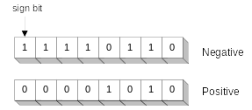
Sign Bit
Highest bit indicates the sign. 1 = negative, 0 = positive
If highest digit of a hexadecimal is > 7, the value is negative
Examples: 8A and C5 are negative bytes
A21F and 9D03 are negative words
B1C42A00 is a negative double-word

Slide 41
Sign Extension
Step 1: Move the number into the lower-significant bits
Step 2: Fill all the remaining higher bits with the sign bit
This will ensure that both magnitude and sign are correct
Examples
  Sign-Extend 10110011 to 16 bits
  Sign-Extend 01100010 to 16 bits
Infinite 0s can be added to the left of a positive number
Infinite 1s can be added to the left of a negative number
10110011 = -77
11111111 10110011 = -77
01100010 = +98
00000000 01100010 = +98

Slide 42
Two's Complement of a Hexadecimal
To form the two's complement of a hexadecimal
  Subtract each hexadecimal digit from 15
  Add 1
Examples:
  2's complement of 6A3D = 95C2 + 1 = 95C3
  2's complement of 92F0 = 6D0F + 1 = 6D10
  2's complement of FFFF = 0000 + 1 = 0001
No need to convert hexadecimal to binary

Slide 43
Binary Subtraction
When subtracting A – B, convert B to its 2's complement
Add A to (–B)
0 0 0 0 1 1 0 0 0 0 0 0 1 1 0 0
0 0 0 0 0 0 1 0 1 1 1 1 1 1 1 0 (2's complement)
0 0 0 0 1 0 1 0 0 0 0 0 1 0 1 0 (same result)
Carry is ignored, because
  Negative number is sign-extended with 1's
  You can imagine infinite 1's to the left of a negative number
  Adding the carry to the extended 1's produces extended zeros
–
+
Practice: Subtract 00100101 from 01101001.

Slide 44
Hexadecimal Subtraction
When a borrow is required from the digit to the left, add 16 (decimal) to the current digit's value
Last Carry is ignored
16 + 5 = 21
-1
1
1
C675
A247
242E
C675
5DB9 (2's complement)
242E (same result)
-
+
Practice: The address of var1 is 00400B20. The address of the next variable after var1 is 0040A06C. How many bytes are used by var1?

Slide 45
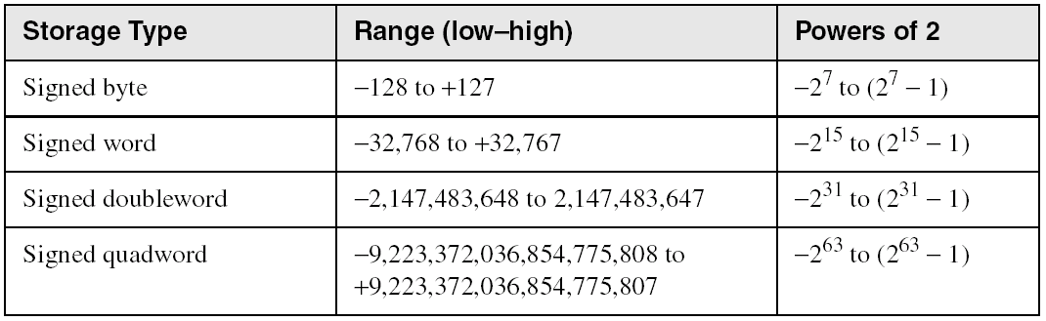
Ranges of Signed Integers
The unsigned range is divided into two signed ranges for positive and negative numbers
Practice: What is the range of signed values that may be stored in 20 bits?

Slide 46
Carry and Overflow
Carry is important when …
  Adding or subtracting unsigned integers
  Indicates that the unsigned sum is out of range
  Either < 0 or >maximum unsigned n-bit value
Overflow is important when …
  Adding or subtracting signed integers
  Indicates that the signed sum is out of range
Overflow occurs when
  Adding two positive numbers and the sum is negative
  Adding two negative numbers and the sum is positive
  Can happen because of the fixed number of sum bits

Slide 47
Carry and Overflow Examples
We can have carry without overflow and vice-versa
Four cases are possible
1
1
1
1
1
1
0
0
0
0
1
1
1
1
15
0
0
0
0
1
1
1
1
15
+
+
0
0
0
0
1
0
0
0
8
1
1
1
1
1
0
0
0
245 (-8)
0
0
0
1
0
1
1
1
23
0
0
0
0
0
1
1
1
7
Carry = 0 Overflow = 0
Carry = 1 Overflow = 0
1
1
1
1
0
1
0
0
1
1
1
1
79
1
1
0
1
1
0
1
0
218 (-38)
+
+
0
1
0
0
0
0
0
0
64
1
0
0
1
1
1
0
1
157 (-99)
1
0
0
0
1
1
1
1
143
(-113)
0
1
1
1
0
1
1
1
119
Carry = 0 Overflow = 1
Carry = 1 Overflow = 1

Slide 48
Character Storage
Character sets
  Standard ASCII: 7-bit character codes (0 – 127)
  Extended ASCII: 8-bit character codes (0 – 255)
  Unicode: 16-bit character codes (0 – 65,535)
  Unicode standard represents a universal character set
    Defines codes for characters used in all major languages
    Used in Windows-XP: each character is encoded as 16 bits
  UTF-8: variable-length encoding used in HTML
    Encodes all Unicode characters
    Uses 1 byte for ASCII, but multiple bytes for other characters
Null-terminated String
  Array of characters followed by a NULL character

Slide 49
Printable ASCII Codes
 | 0 | 1 | 2 | 3 | 4 | 5 | 6 | 7 | 8 | 9 | A | B | C | D | E | F
2 | space | ! | " | # | $ | % | & | ' | ( | ) | * | + | , | - | . | /
3 | 0 | 1 | 2 | 3 | 4 | 5 | 6 | 7 | 8 | 9 | : | ; | < | = | > | ?
4 | @ | A | B | C | D | E | F | G | H | I | J | K | L | M | N | O
5 | P | Q | R | S | T | U | V | W | X | Y | Z | [ | \ | ] | ^ | _
6 | ` | a | b | c | d | e | f | g | h | i | j | k | l | m | n | o
7 | p | q | r | s | t | u | v | w | x | y | z | { | | | } | ~ | DEL
Examples:
  ASCII code for space character = 20 (hex) = 32 (decimal)
  ASCII code for 'L' = 4C (hex) = 76 (decimal)
  ASCII code for 'a' = 61 (hex) = 97 (decimal)

Slide 50
Control Characters
The first 32 characters of ASCII table are used for control
Control character codes = 00 to 1F (hex)
  Not shown in previous slide
Examples of Control Characters
  Character 0 is the NULL character ⇒ used to terminate a string
  Character 9 is the Horizontal Tab (HT) character
  Character 0A (hex) = 10 (decimal) is the Line Feed (LF)
  Character 0D (hex) = 13 (decimal) is the Carriage Return (CR)
  The LF and CR characters are used together
    They advance the cursor to the beginning of next line
One control character appears at end of ASCII table
  Character 7F (hex) is the Delete (DEL) character

Slide 51
Terminology for Data Representation
Binary Integer
  Integer stored in memory in its binary format
  Ready to be used in binary calculations
ASCII Digit String
  A string of ASCII digits, such as "123"
ASCII binary
  String of binary digits: "01010101"
ASCII decimal
  String of decimal digits: "6517"
ASCII hexadecimal
  String of hexadecimal digits: "9C7B"

Slide 52
Summary
Assembly language helps you learn how software is constructed at the lowest levels
Assembly language has a one-to-one relationship with machine language
An assembler is a program that converts assembly language programs into machine language
A linker combines individual files created by an assembler into a single executable file
A debugger provides a way for a programmer to trace the execution of a program and examine the contents of memory and registers
A computer system can be viewed as consisting of layers. Programs at one layer are translated or interpreted by the next lower-level layer
Binary and Hexadecimal numbers are essential for programmers working at the machine level.

